Slide 1
Excel Final Assessment
Ashutosh kumar Gupta
Emp Id:- 4266

Slide 2
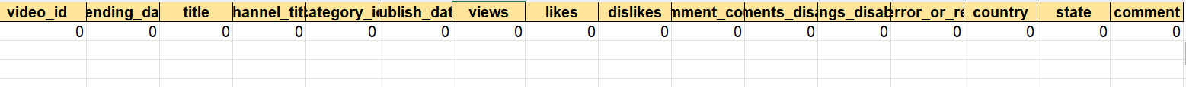
Question 1
In the dataset there was no null values and no duplicate values are present
I checked for the null values for the dataset using the countblank() function for each column.
Forumula used==COUNTBLANK('Q1'!A$2:A$593)

Slide 3
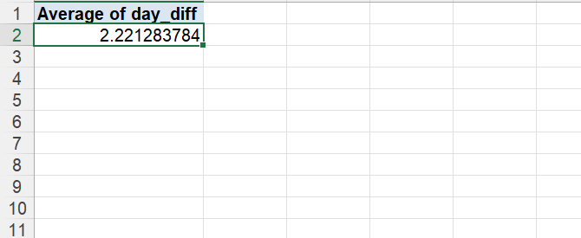
Question 2
I have used the datediff() function to calculate the difference between the publish date and the trending date and I have use day as unit.
After finding the day difference for all the videos I have created a pivot table and calculated the average of the day difference
The average difference is 2.22 days.
Hence we can say that it takes 2.22 days on an average for a video to trend after it is published.

Slide 4
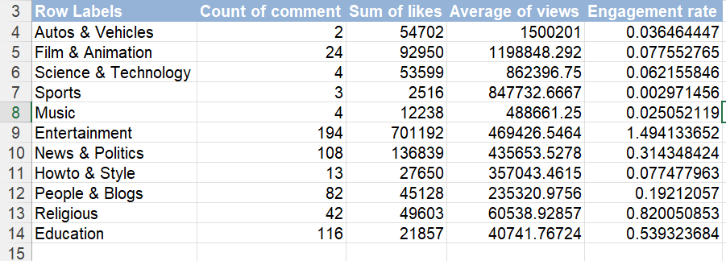
Question3
In this question I have first created the category column with the help of xlookup function
After creating the category column for each row I have created a pivot table and calculated the average view for each category.
After that I have calc
ulated the engagement rate for each category.

Slide 5
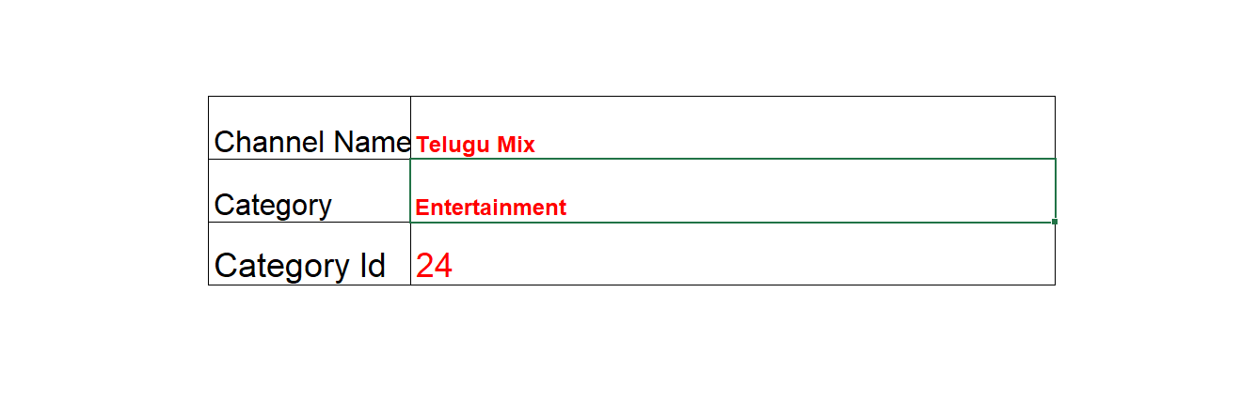
Question 4
In this question after mapping all the category id with the category name I have used data validation to select channel name via dropdown list
And with the help of xlookup if have found the category and category Id of the channel

Slide 6
Question 5

Slide 7
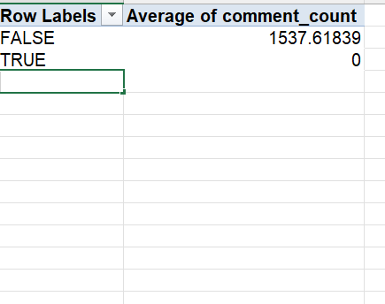
Question 6
In this question I have used pivot table to group videos on the basis of their comment_disabled and the I have calculate the average of comment for both the groups

Slide 8
Question 7
In this question I have created a dashboard for each category and in that I have mentioned KPI such as likes dislikes and comment count

Slide 9
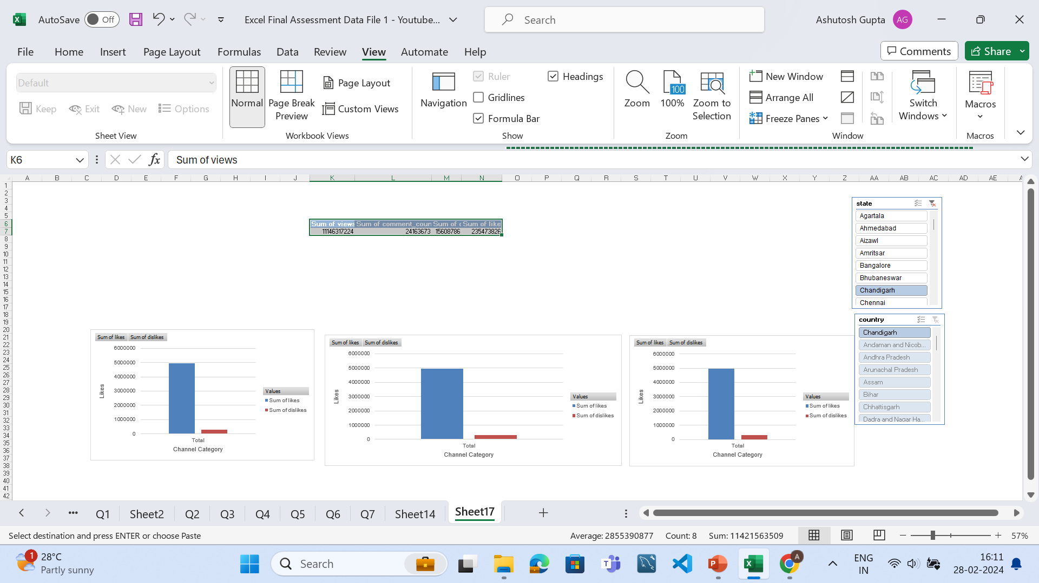

Slide 10
Question 8
In this question I have calculated the sum of view, likes and comment count of each video with the help of pivot table after finding these values I have calculated the engagement rate by adding likes and comment.
After finding engagement rate I have calculated the Category for each video.
After that I have again created a pivot table and then I have used category as filter and values as sum of engagement and in rows I have put video id
Then for each category I can find the top 5 videos.

Slide 11
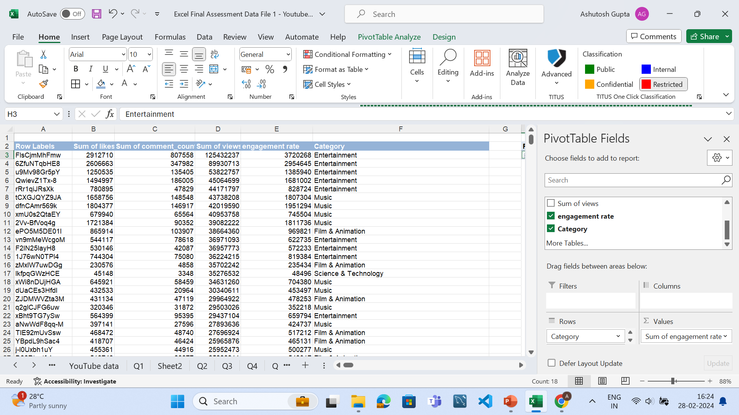

Slide 12
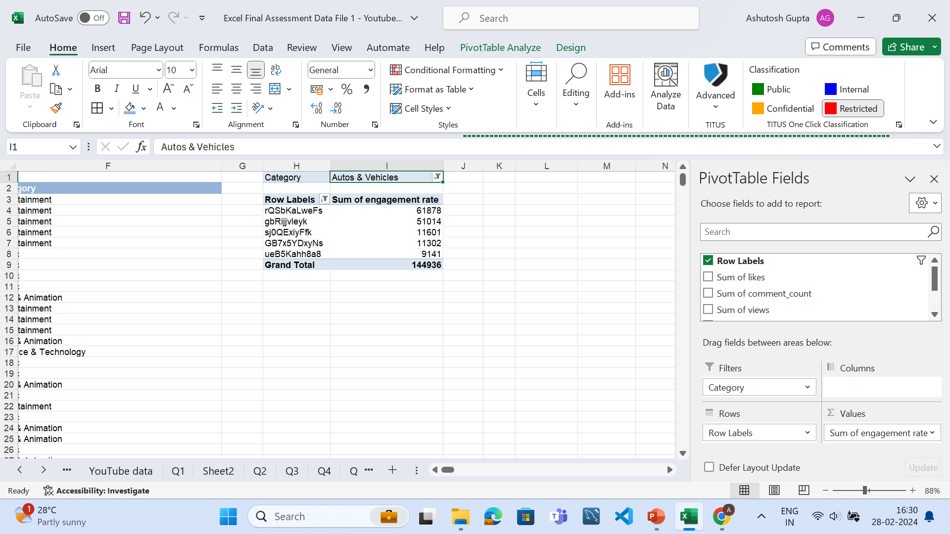

Slide 13
Question 9
In this question firstly I have applied filter of year of publish and I have seleced only those videos that were released on year 2018 and after that I have applied filter on the likes and selected only those videos that have more than 10000 likes
After that I have created a pivot table and looked for the category with most number of view
And I found that “Entertainment” category has the most view in the year 2018 for videos that have more than 10000 likes.

Slide 14
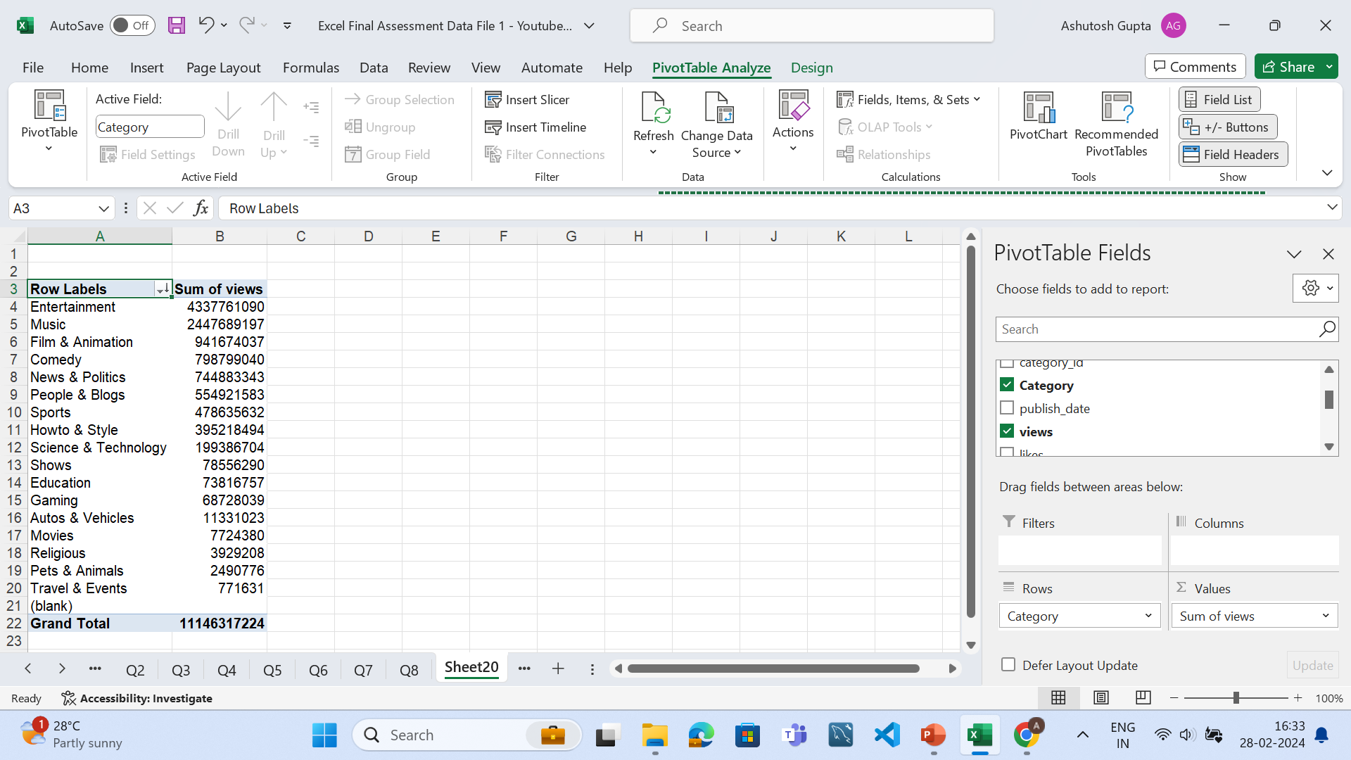

Slide 15
Question 10
In this question firstly I have calculated the year for each video using year() function
After that created a pivot table and with the help of that I have calculated the sum of likes, dislikes, commentcount and view and did a comparison between then.
On comparing the data it can be concluded that engagement in youtube increase in the year of 2018 than that of 2017.

Slide 17
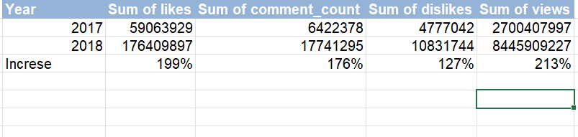

Slide 18
Question 11
In this question I have grouped the data according to year published
And then I have calculated the sum of likes, dislikes,
And it is evident that the engagement increases in the year 2018

Slide 19
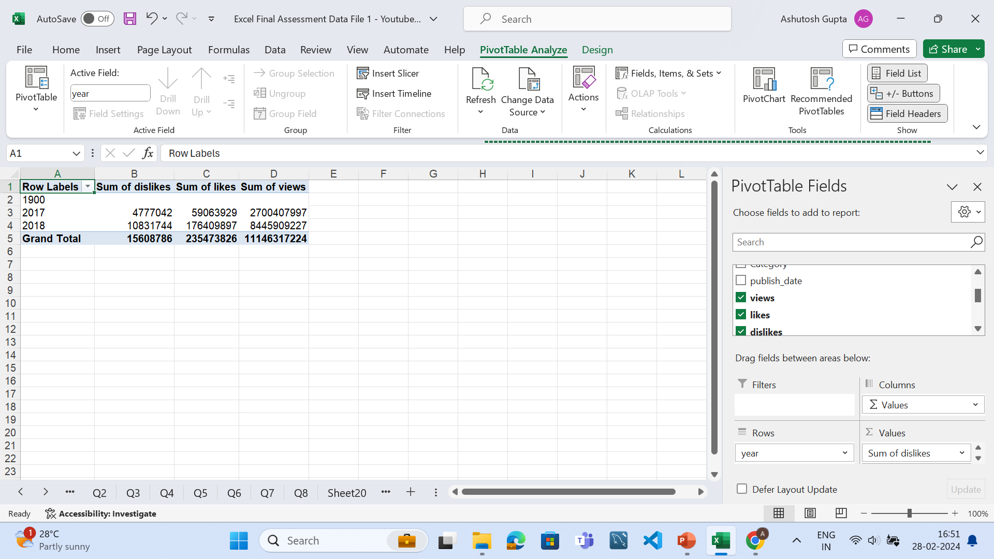

Slide 20
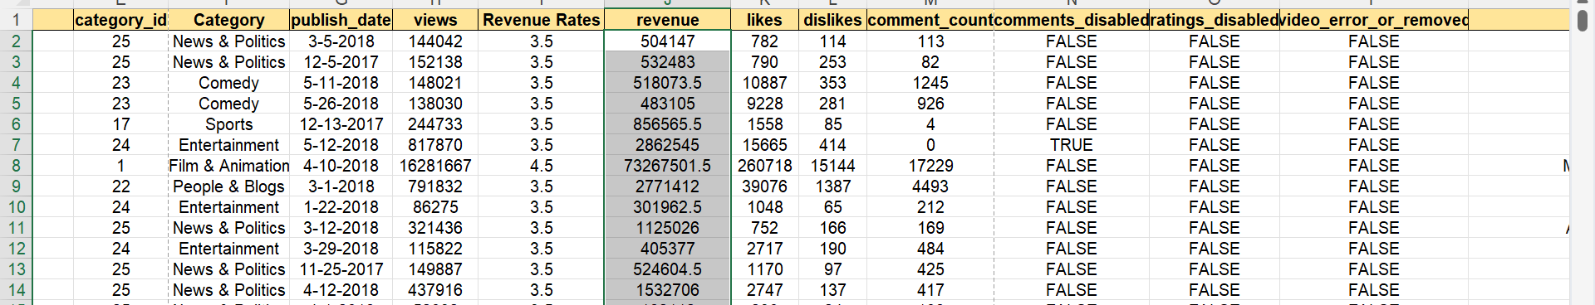
Question 12
In this question I have created two new columns one is revenue rates and other is revenue
In the revenue rates I have given the condtion to determine the rates and in revenue I have multiplied the rate with view

Slide 21
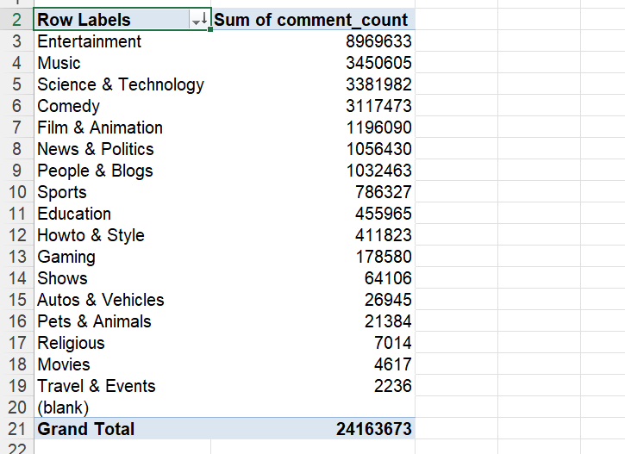
13
In this question I have created a pivot table in which I have used category as row and sum of comment count as values
So after sorting we get that entertainment is the category with the highest sum of comment

Slide 22
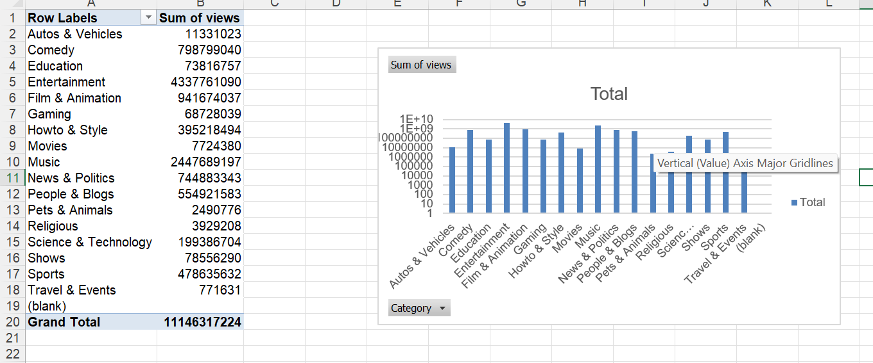
14
In this question I have used pivot table to find sum of view for each category plotted this graph

Slide 23
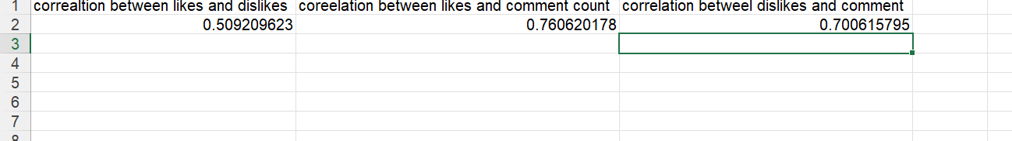
15 in this question using correl I have calculated correlation between likes,dislikes and comment

Slide 24
If likes increases then dislikes also increases
If likes increases then comment also increases
If dislikes incresses the comment also increases

Slide 25
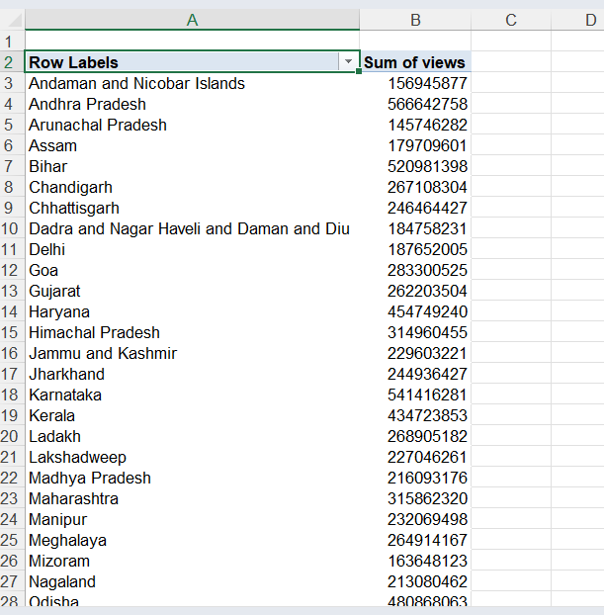
Q16

Slide 26
For question 16 I have used pivot table and used country as rows and sum of views as values.

Slide 27
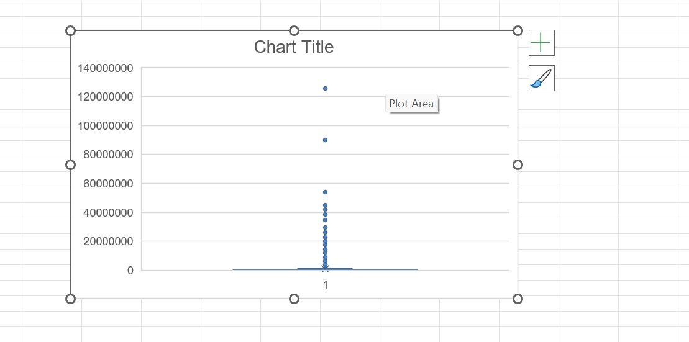
17
In this I have used box plot to foind outliers

Slide 28
18
In this question I have calculated the comment count according to view of channel 1 kg biriyani

Slide 29
19 In this question I have plotted the sum of likes, dislikes and comment

Slide 30
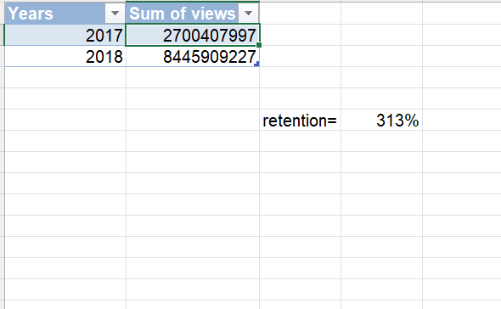
20
On the baseis of view we calculated that the retention is around 313%

